Slide 1
Iterators in Python
A Theoretical Overview with Examples

Slide 2
Introduction to Iterators
In Python, an iterator is an object that represents a stream of data. It enables you to traverse through a sequence of elements, such as lists, tuples, strings, and more, one at a time. Iterators are used extensively in Python, often in conjunction with loops, to efficiently process and manipulate data.

Slide 3
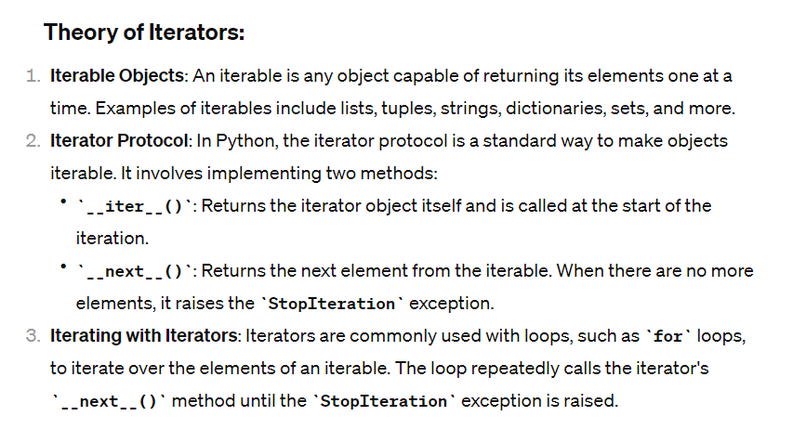

Slide 4
Example 1: Creating an Iterator Class
Example 2: Using built-in Iterators
my_list = [1, 2, 3, 4, 5]
my_iterator = iter(my_list) # Creates an iterator from the list
print(next(my_iterator)) # Output: 1
print(next(my_iterator)) # Output: 2
class MyIterator:
def __init__(self, data):
self.data = data
self.index = 0
def __iter__(self):
return self
def __next__(self):
if self.index >= len(self.data):
raise StopIteration
value = self.data[self.index]
self.index += 1
return value
my_iter = MyIterator([1, 2, 3, 4, 5])
for item in my_iter:
print(item)
Example 3: Using Iterators with Generators
def my_generator():
yield 1
yield 2
yield 3
gen_iterator = my_generator() # Creates an iterator from the generator
print(next(gen_iterator)) # Output: 1
print(next(gen_iterator)) # Output: 2

Slide 5
Example 4: Using built-in Iterators with Iterable Objects
my_string = "Hello"
str_iterator = iter(my_string) # Creates an iterator from the string
print(next(str_iterator)) # Output: 'H'
print(next(str_iterator)) # Output: 'e'
These examples demonstrate the creation and usage of iterators in Python, illustrating how they can be implemented using custom classes, built-in iterables, generators, and iterable objects. Iterators are fundamental for efficient data processing and manipulation in Python.

